Slide 1



EV Vehicle/Charging Demand Prediction
By: Prince Kothiwal

Slide 2

Learning Objectives
Understand trends in EV adoption
Predict future EV demand using historical data
Visualize EV growth for different counties
Build a Streamlit dashboard for forecast interaction
GOAL
Build an interactive system to forecast EV growth and charging demand using machine learning.
Source :
www.freepik.com/

Slide 3
Tools and Technology used
Python
Streamlit
scikit-learn
pandas
numpy
matplotlib
joblib

Slide 4
Methodology
Data Collection & Preprocessing
Feature Engineering (lags, rolling mean, etc.)
Model Training (using past EV trends)
Deployment via Streamlit Dashboard

Slide 5
Problem Statement:
Accurate forecasting of EV demand is essential for energy planning and infrastructure development.
Existing methods lack interactive and county-wise forecasting capabilities.

Slide 6
Solution:
ML-based forecasting using historical EV data
Predict next 3 years of EV growth
County-wise prediction using a trained model
Visual & interactive forecasting via Streamlit
GitHub Link: https://github.com/prince80000/EV-Vehicle_weeK-3.git

Slide 7
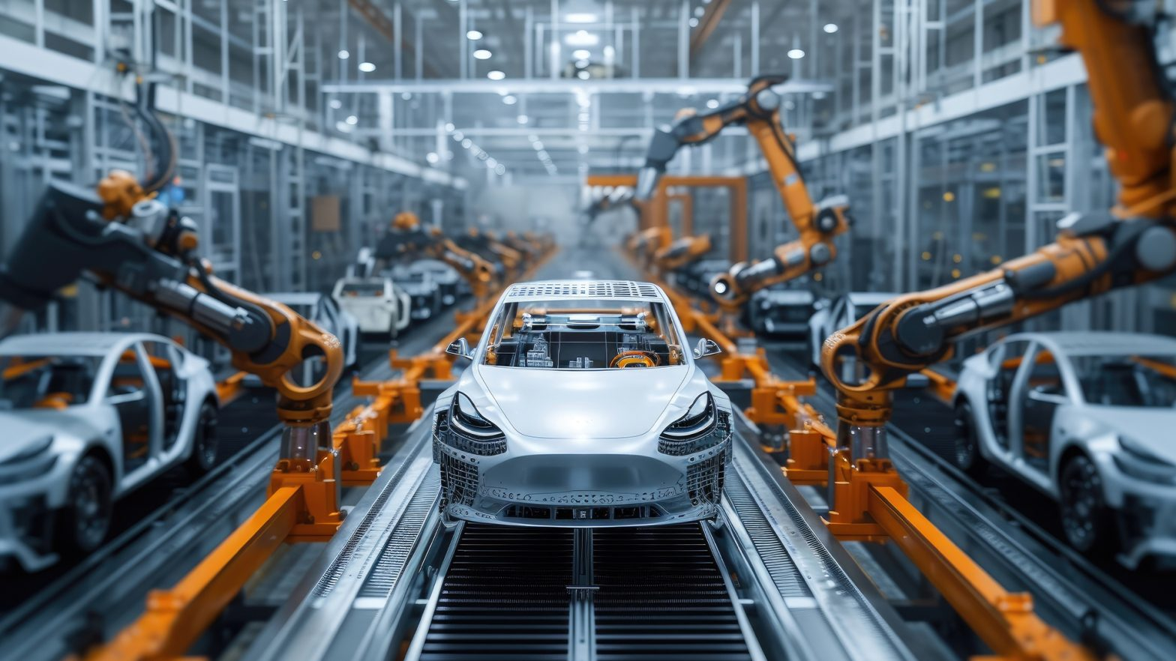
Screenshot of Output:
EV car factory image
Forecast dashboard screenshot

Slide 8
Conclusion:
Interactive tool simplifies forecasting EV trends
Supports strategic planning for energy and infrastructure
Scalable to multiple regions and real-time updates

